Slide 1
Connected Products on SCP

Slide 2
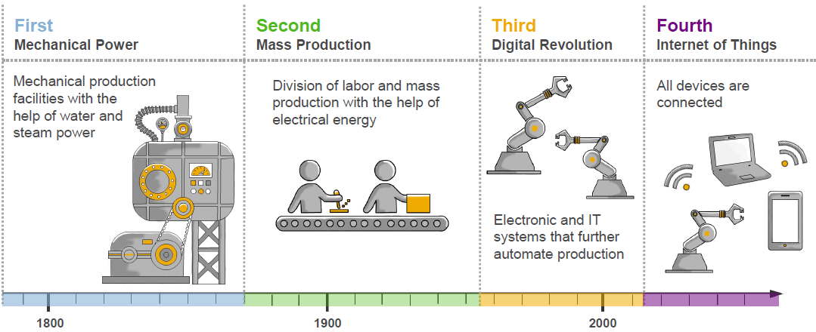
Industrial revolutions and the impact on ERP – From Industry 1.0 to 4.0
Industrial Revolution
Impact on ERP
Manual
Enterprise
Transaction
Enterprise
Digital
Enterprise
Intelligent
Enterprise
Self-Driving Enterprise

Slide 3
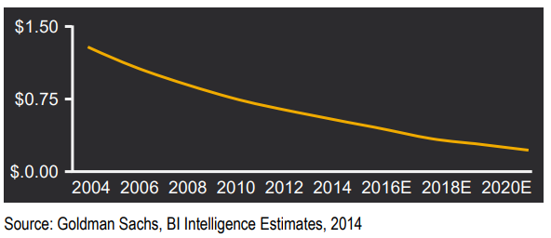
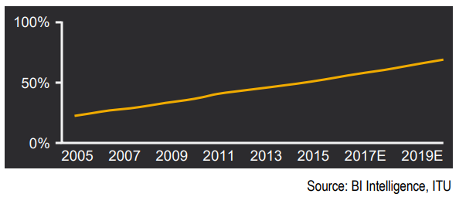
Why Quinnox needs to invest now??
Estimated Penetration of Global Population
Using the Internet
Average Sensor Cost Forecast
In 2020, SAP predicts that about 30 billion devices will be connected. By 2025, this number rockets to 80 billion devices.
By 2020, SAP think that IoT will account for over $1.3 trillion of global IT spending across every industry.
IOT is booming because of Availability, Affordability and Scalability

Slide 4
How SAP is reacting to this?
SAP Leonardo Internet of Things (IoT) is one of the capabilities of SAP Leonardo, and includes Internet of Things (IoT) solutions that enables companies to realize the digital transformation.
SAP Cloud Platform with its Internet of Things service enables to go from sensor to action. The Internet of Things service supports you to quickly connect your applications and processes with machines and devices in the field and derive actions out of the data they produce.

Slide 5
How Quinnox can leverage this opportunity?
Past capability:
Building IoT enabled water purifier for EFL
Our experience of cellphone controlled FAN POC for Orient Electric
Current Knowledge and Experience with Leonardo
We can build a “Connected Products” platform
It will enable organizations with an out of box framework using which they can rapidly leverage the benefits of IOT in a cost effective fashion
Key Investment required in building an “Embedded Analytics” team
Benefits:
All products connected
Remote Fault Diagnosis
Monitoring
Business Insights
Product Insights
Customer Management
Service Technician Management

Slide 6
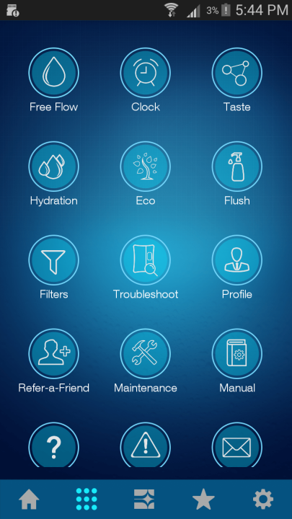
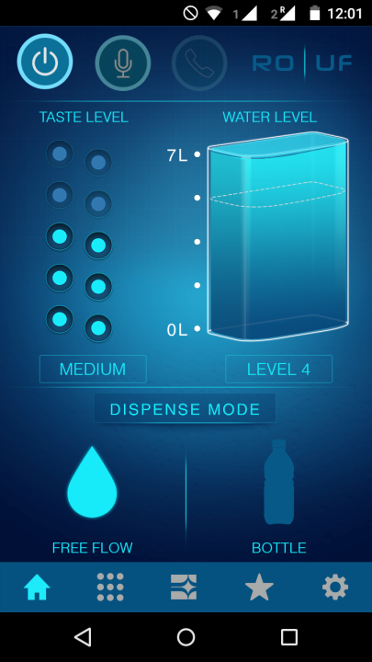
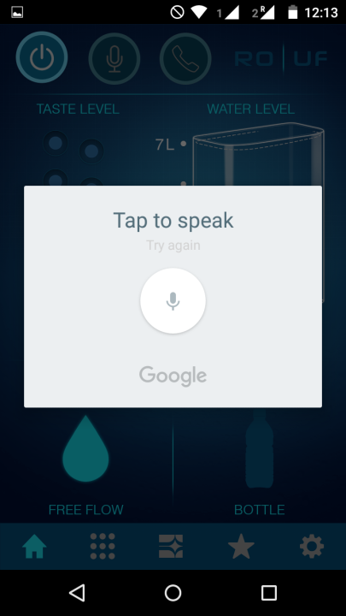
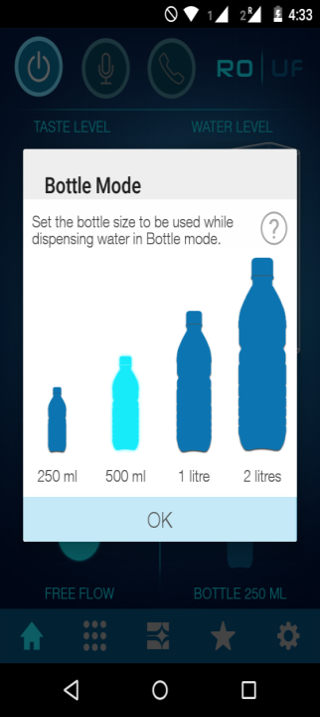
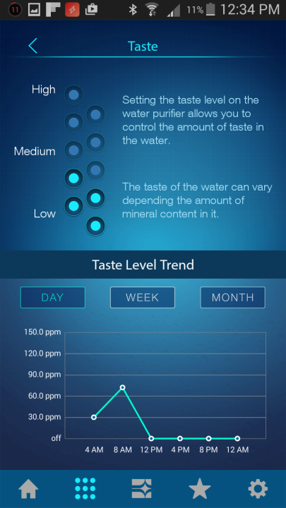
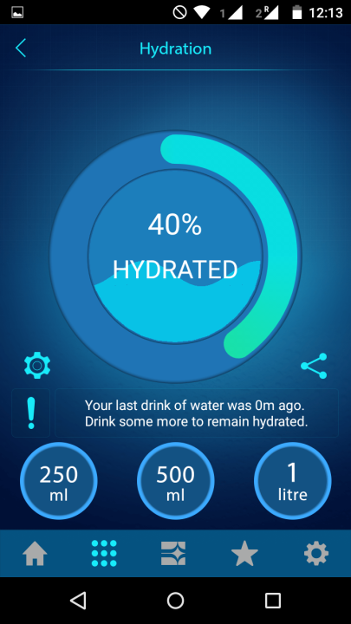
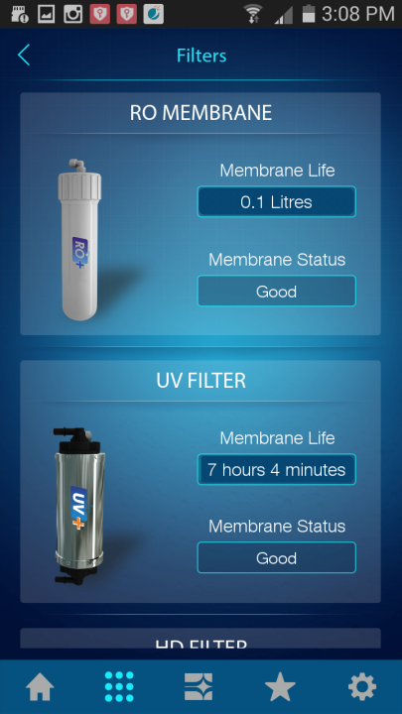
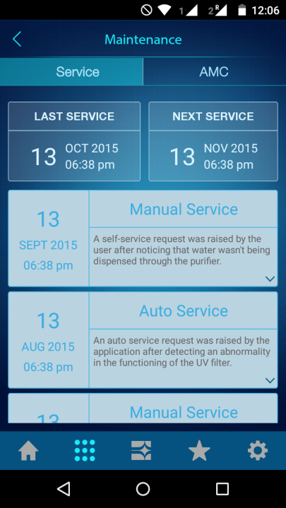
IoT – H2O meets SAP
IOT enabled smart water purifier
1
2
3
4
5
6
Purifier with in built microcontroller that provides seamless connectivity to internet and SAP System
Technician mobile App to integrate technicians with SAP System
Customer mobile app to get the customer connected to their purifier all the time
In-built microcontroller chip continuously provides data on functioning, water quality and usage etc... to the IOT server
Predictive maintenance and malfunctioning data of purifier sent to SAP via IOT server
“Fitbit” type dashboards to customer on their water consumption
Customer and service team gets regular notifications regarding services

Slide 7
Demo

Slide 8
Questions ?

Slide 9
Thank You

